Slide 1
SOEN 6611 - Software Measurement
Team I
Submitted By:
Chetan Paliwal 40083388
Himen Hitesh Sidhpura 40091993
Sandeep Siddaramaiah 40087428
Karthik B P 40094485
Rohan Deepak Paspallu 40093648
Submitted To:
Jinqiu Yang

Slide 2
Agenda
Getting Project Ready on Machine & Project Used
Statement Coverage, Branch Coverage, Cyclomatic Complexity
Mutation Testing
M-5: Adaptive Maintenance Effort
M-6: Software Defect Density
Correlations
Statement Coverage - Mutation Score.
Branch Coverage - Mutation Score
Statement, Branch coverage and Software defect density
Statement, branch coverage and cyclomatic complexity
Adaptive maintenance effort and software defect density
Notes:
Tool used for data collection
Data collected

Slide 3
Project Used:
Sr. No. | Project | Lines of Code | Description
1. | Apache Commons Lang | 79.8K | is used as a helper class for the utilities in the java.lang API.
2. | Apache Commons Logging | 9.63K | This project is used as a process when writing a library to write log information to keep a checkpoint of the changes made in the libraries.
3. | Apache Commons Collections | 132 K | This project is a Collections Framework to include various data structures that help us in faster development of java applications.
4. | Apache Commons Math | 186K | This project is a self-contained mathematics and statistics library that solves the most common problems in a java program.
5. | JFreechart | 167 K | JFreeChart is a chart library that is used for the development of various types of charts

Slide 4
Getting Project Ready on Machine:
We imported the project into the eclipse.
We resolved the dependencies errors and compiled them successfully.
We ran the tool and determined the statement coverage, branch coverage and cyclomatic complexity.
We ran the pitclipse tool on eclipse oxygen and determined the mutation score.

Slide 5
M-1, M-2, M-4 : Statement Coverage, Branch Coverage, Cyclomatic Complexity:
Tool Used: JaCoCo [1]
Why we used JaCoCo:
Free and Open-Source code coverage library for Java
Coverage analysis of branches, lines, methods, and cyclomatic complexity
Several report formats (HTML, XML, CSV)
Integration with Various Tools (Eclipse, Ant Tasks, Maven plug-in, Gradle)
[1] https://www.eclemma.org/jacoco/

Slide 6
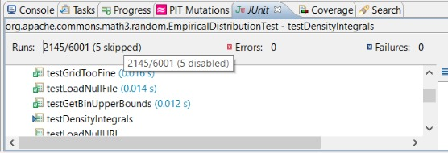
Challenges Faced:
Build multiple version of same project to get the analysis result.
Resolve dependency error.
Ignoring the test cases(@Ignore) which show no coverage.

Slide 7
Analysis Result:
Sr. No. | Project | Statement Coverage | Branch Coverage | Cyclomatic Complexity
1. | Apache Commons Lang | 0.9428 | 0.8431 | 22.1061
2. | Apache Commons Logging | 0.5030 | 0.3904 | 12.1411
3. | Apache Commons Collections | 0.8940 | 0.7884 | 14.0750
4. | Apache Commons Math | 0.9446 | 0.8421 | 14.9606
5. | JFreechart | 0.7203 | 0.4680 | 24.5338

Slide 8
M-3 Mutation Testing
Tool Used: PitClipse[2]
Why we used PitClipse:
Free and Open-Source code coverage library for Java
Coverage analysis of branches, lines, methods, and cyclomatic complexity
Several report formats (HTML, XML, CSV)
Integration with Various Tools (Eclipse, Ant Tasks, Maven plug-in, Gradle)
[2] https://marketplace.eclipse.org/content/pitclipse

Slide 9
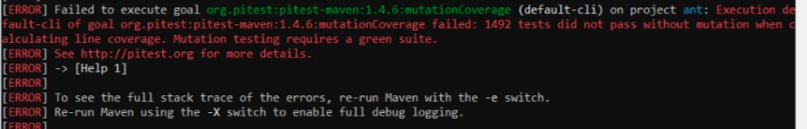
Challenges Faced
Multiple timeouts while analysis project.
Ignoring the test cases(@Ignore), which didn’t pass without mutation when calculating line coverage .

Slide 10
Types of Mutator:
Various types of Mutator used for our Project:
CONDITIONALS_BOUNDARY_MUTATOR
INCREMENTS_MUTATOR
INVERT_NEGS_MUTATOR
MATH_MUTATOR
NEGATE_CONDITIONALS_MUTATOR
RETURN_VALS_MUTATOR
VOID_METHOD_CALL_MUTATOR
and so on...

Slide 11
Working of Pitclipse:
1. Pitest inserts mutants into a jvm by re-writing the class after it has loaded.
2. PIT chooses and prioritises tests based on three factors
Line coverage
Test execution speed
Test naming convention
3. Per test line coverage information is gathered, discarding all the lines which does not exercise mutated code..
4. The remaining tests are then ordered by increasing execution time - test cases that belong to a class that is identified as a unit test for the mutated class are weighted above other tests.

Slide 12
Mutation Testing Results:
Sr. No. | Project | Mutation Testing Result
1. | Apache Commons Lang | 87%
2. | Apache Commons Logging | 26%
3. | Apache Commons Collections | 42%
4. | Apache Commons Math | 79%
5. | JFreechart | 33%

Slide 13
M-5 Adaptive Maintenance Effort Model
In this model, various metric are identified based on software development process, This metric can DLOC, Halstead, Noptr, Coupling Factor etc.
By performing regression analysis, it was found that metric such as number of lines of code changed and number of operator changed are strongly correlated to maintenance effort.
In this model, 70% of data collected is used to build the model while remaining 30% for validating the model.
For evaluating model, simple regression and multiple regression is performed to identify correlation.
Regression result in maintenance effort(E), E = 78 + 0.01DLOC, DLOC is number of lines of code changed.
[1] J. Hayes, S. Patel and L. Zhao, "A metrics-based software maintenance effort model," IEEE, 2004.

Slide 14
Approach:
We determined the Difference in lines of code for various version of project using CLOC tool.
We determined the effort for various version of project.
E = 78 + 0.01 * DLOC [3], E is maintenance effort in person hours
Tool Used: CLOC
[3] J. Hayes, S. Patel and L. Zhao, "A metrics-based software maintenance effort model," IEEE, 2004.

Slide 15
CLOC
Why CLOC:
Free and Open-Source code coverage library for Java
Coverage analysis of branches, lines, methods, and cyclomatic complexity
Allows results from multiple runs to be summed together by language and by project.
Has no dependencies outside the standard Perl distribution.
Results can be produced in a variety of formats: plain text, SQL, XML, comma separated values.
Challenges Faced:
Requires additional tool dependencies(Perl,Node.js,).
Tried various troubleshooting options to get the result in required format.

Slide 16
Adaptive Maintenance Effort Results:
Sr. No. | Project | Version | DLOC | Effort Required(Person Hours)
1. | Apache Commons Math | 3.6 | 16556 | 243.56
 |  | 3.6.1 | 151 | 79.51
 |  | 3.5 | 3232 | 110.32
 |  | 3.4 | 10577 | 183.77
 |  | 3.4.1 | 221 | 80.21
 |  | 3.3 | 30913 | 387.13
 |  | 3.2 | 13642 | 214.42
 |  | 3.1 | 46381 | 542.21

Slide 17
M-6 Software Defect Density
Defect Density tries to find a relation between the external software characteristic(quality) and internal product attributes(size)[4].
Defects are faults in the program that , when executed may cause a failure in the software system.
We are finding the defect density at the project level and not at class level or function level.
We do this since our effort(Metric 5) is also calculated at the project level(Difference in lines of code through out the project), so that data we are comparing are not disturbed.
[4] H. Zhang, "An Investigation of the Relationships between Lines of Code and Defects," IEEE.

Slide 18
Approach:
We analysed the bugs of various versions of all the 5 projects.
We determined the defect/bug density.
Defect Density = Number of defects/KLOC
KLOC = Number of lines of code in thousand.
Lines of code are calculated excluding blank lines and comments.

Slide 19
Software Defect Density Results: (Version-wise)
Sr. No. | Project | Version | Number of Bugs | KLOC | Software Defect Density
1. | Apache Commons Math | 3.6 | 9 | 222.070 | 0.0405
 |  | 3.6.1 | 29 | 222.167 | 0.1305
 |  | 3.5 | 35 | 208.918 | 0.1675
 |  | 3.4 | 7 | 207.686 | 0.0337
 |  | 3.4.1 | 13 | 207.875 | 0.0625
 |  | 3.3 | 36 | 199.122 | 0.1807
 |  | 3.2 | 36 | 173.152 | 0.2079
 |  | 3.1 | 8 | 162.806 | 0.0491

Slide 20
Software Defect Density Results: (Project-wise)
Sr. No. | Project | Number of Bugs | KLOC | Software Defect Density
1. | Apache Commons Lang | 4 | 81.888 | 0.04884
2. | Apache Commons Logging | 1 | 9.665 | 0.10357
3. | Apache Commons Collections | 4 | 67.036 | 0.05966
4. | Apache Commons Math | 29 | 222.167 | 0.13053

Slide 21
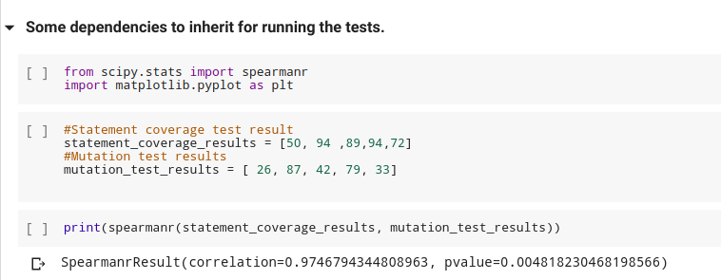
Correlation (Statement Coverage, Mutation Score):

Slide 22
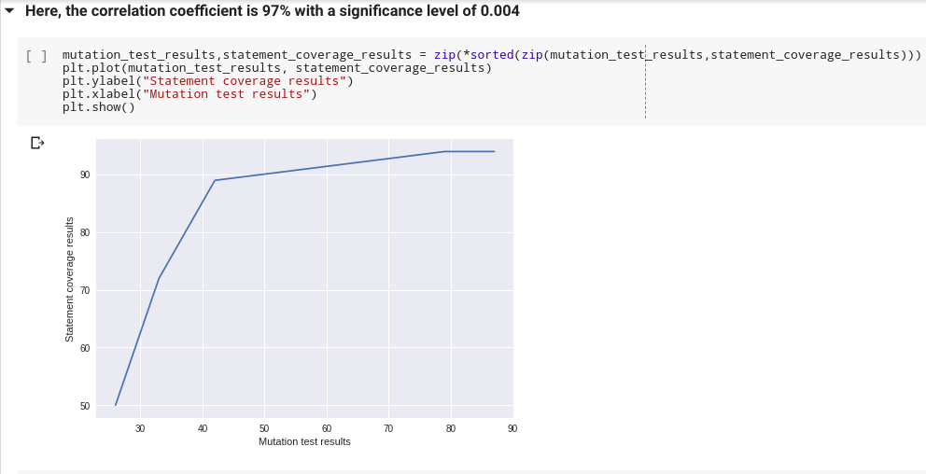
Graph (Statement Coverage, Mutation Score)

Slide 23
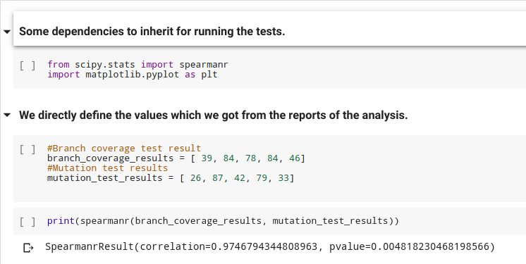
Correlation (Branch Coverage, Mutation Score):

Slide 24
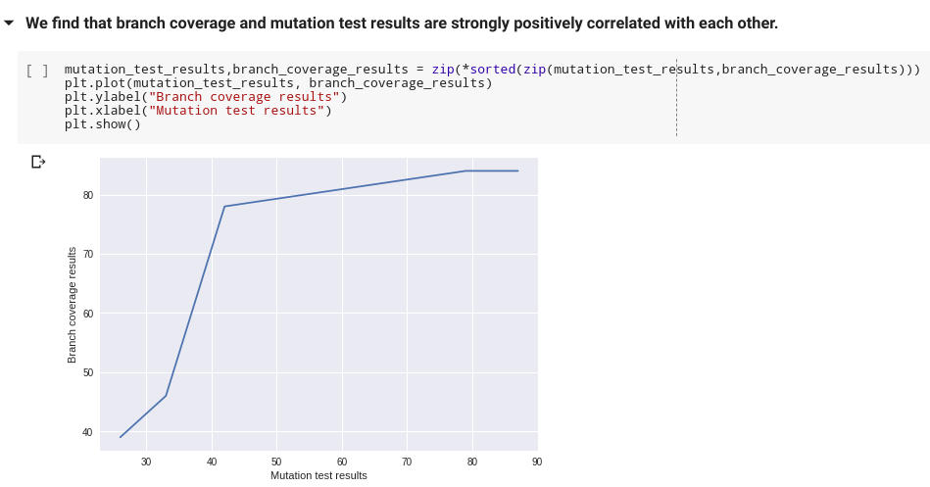
Graph (Branch Coverage, Mutation Score)

Slide 25
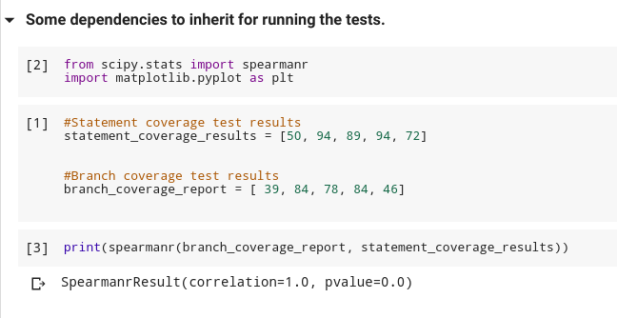
Correlation (Statement Coverage, Branch Coverage, Software defect density):

Slide 26
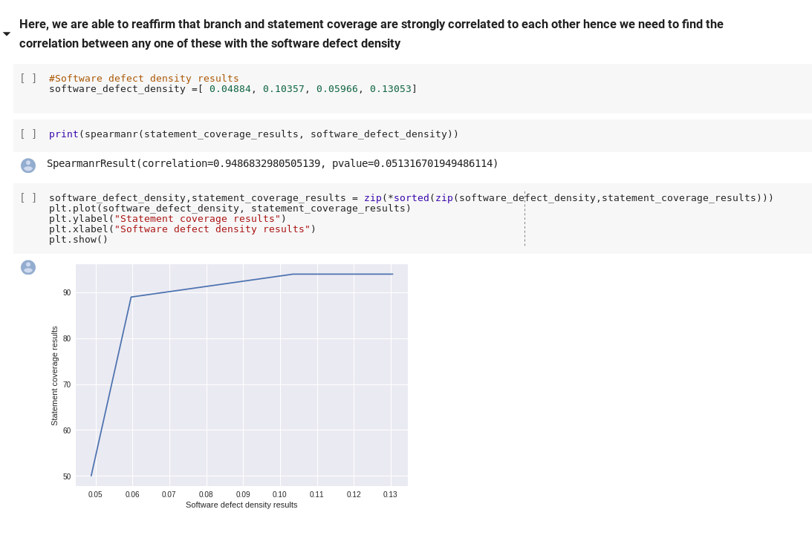
Correlation (Statement Coverage, Software Defect Density):

Slide 27
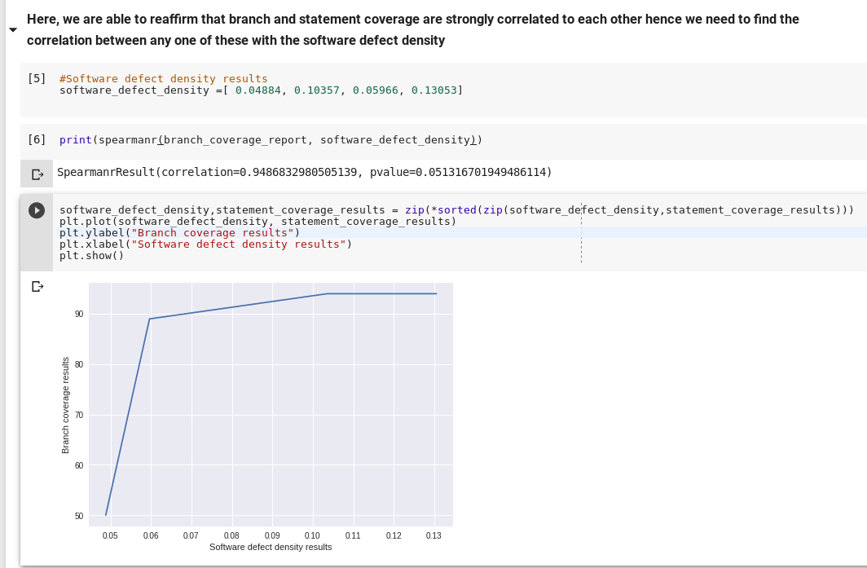
Correlation (Branch Coverage, Software Defect Density):

Slide 28
Correlation (Statement Coverage, Branch Coverage, Cyclomatic complexity):

Slide 29
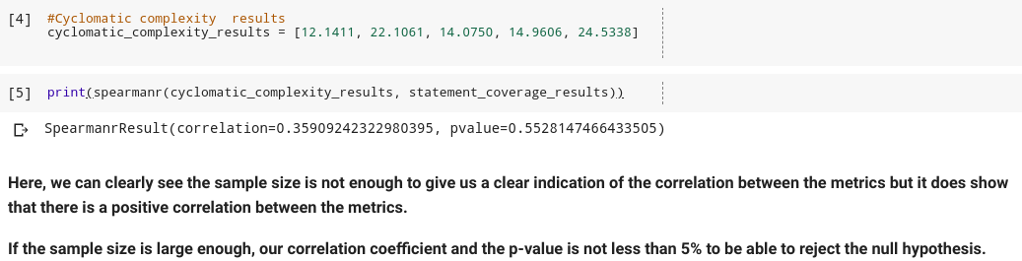
Correlation (Statement Coverage, Branch Coverage, Cyclomatic Complexity):

Slide 30
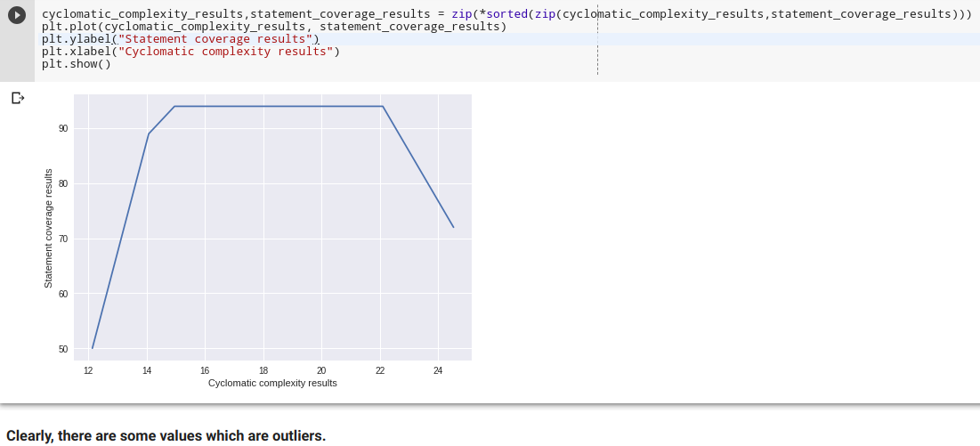
Correlation (Statement Coverage, Branch Coverage, Cyclomatic Complexity): Graph

Slide 31
Correlation (Adaptive Maintenance Effort, Software Defect Density):
It is widely believed that some internal properties of software, such as size, have relationships with software quality.
Defect density finds number of defects per thousand lines of code and Effort is calculated based on the difference in lines of code.
Since there is believed to be a relation between lines of code and defects, we try to extend this and relate difference in lines of code and defects reported for various versions.
The relation we got after applying Spearman’s coefficient is negative but with a high p-value.
We believe the sample size of our data is not enough to confirm our observations and hence the high p-value.

Slide 32
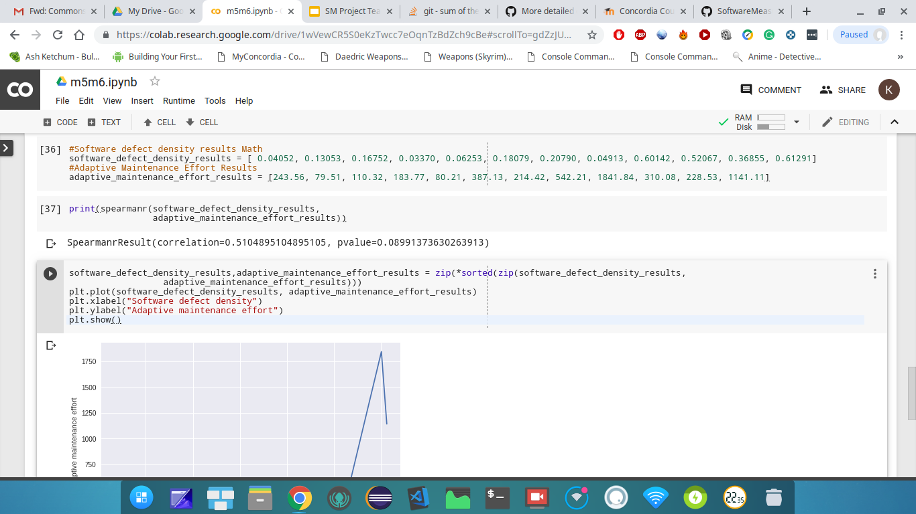
Correlation : Software defect density and Adaptive maintenance (For Commons Math)

Slide 33
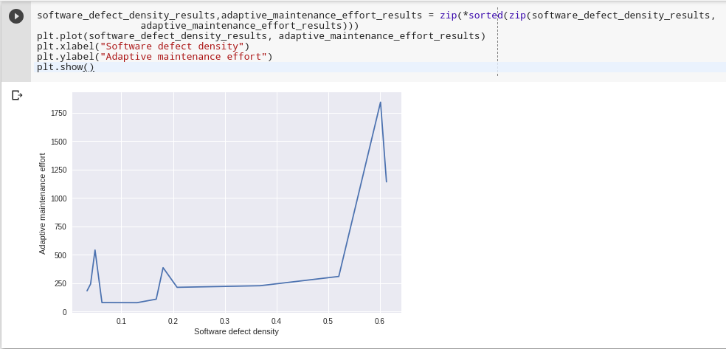
Correlation graph: Software defect density and Adaptive maintenance: *(Refer slide 16 for data)

Slide 34
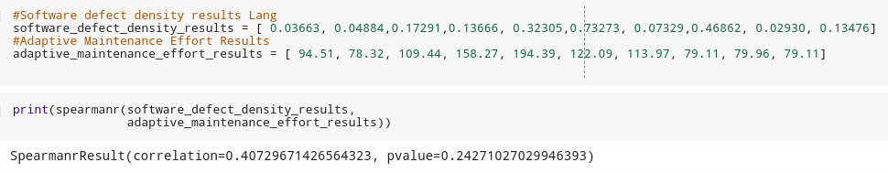
Correlation : Software defect density and Adaptive maintenance (For Commons Lang)

Slide 35
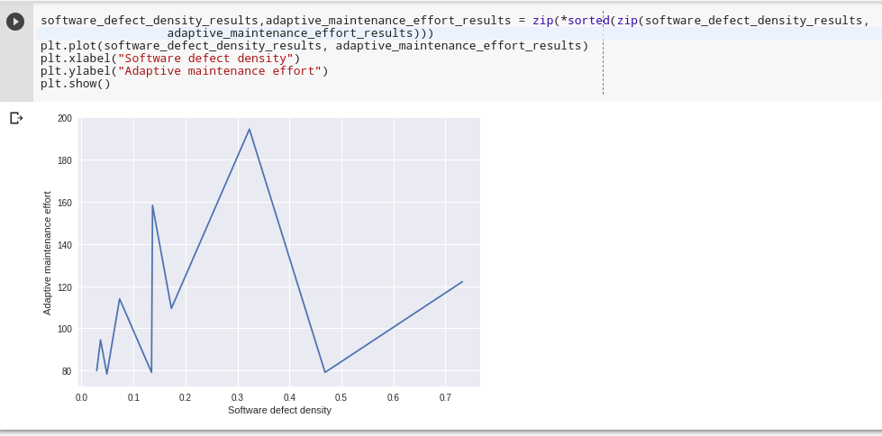
Correlation graph: Software defect density and Adaptive maintenance:

Slide 36
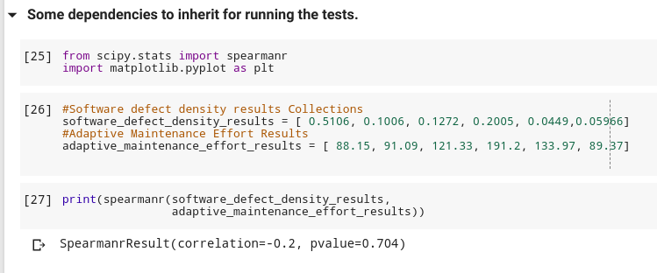
Correlation : Software defect density and Adaptive maintenance (For Commons Collections)

Slide 37
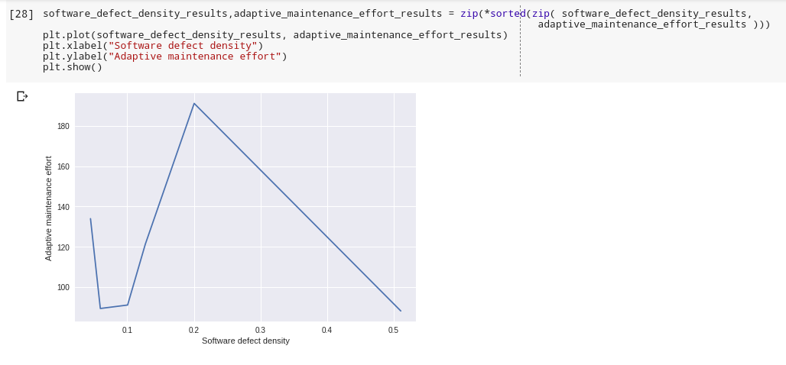
Correlation graph: Software defect density and Adaptive maintenance:

Slide 38
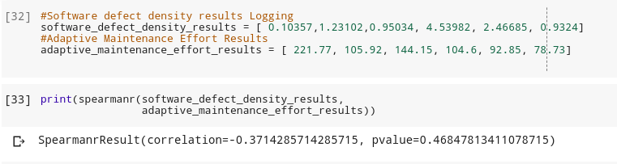
Correlation : Software defect density and Adaptive maintenance (For Commons Collections)

Slide 39
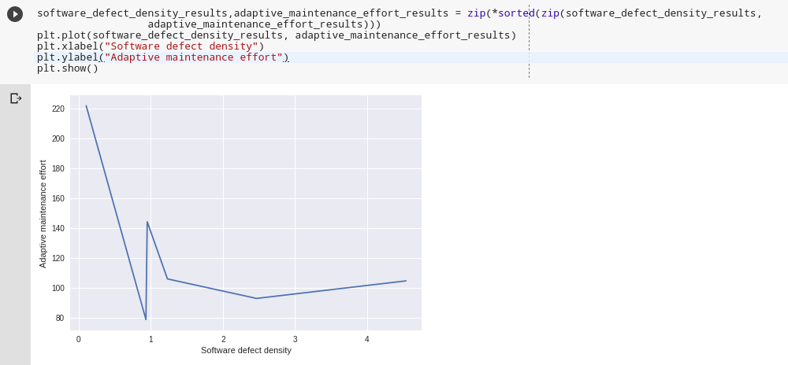
Correlation graph: Software defect density and Adaptive maintenance:

Slide 40
References:
M. M. S. Sarwar, S. Shahzad and I. Ahmad, "Cyclomatic complexity: The nesting problem," IEEE, 2014.
H. Zhang, "An Investigation of the Relationships between Lines of Code and Defects," IEEE.
SmartBear Software, "https://support.smartbear.com/collaborator/docs/reference/metrics.html".
Guru99, "Mutation Testing in Software Testing: Mutant Score & Analysis Example," https://www.guru99.com/mutation-testing.html, 2019.
J. Hayes, S. Patel and L. Zhao, "A metrics-based software maintenance effort model," IEEE, 2004.

